Slide 1
Facial Analyzer for Rhinoplasty (Option 9)
Priscilla Carbo, Marvin Cazeau, Jared Curtis, Alessandra Oo, Maree Sky

Slide 2
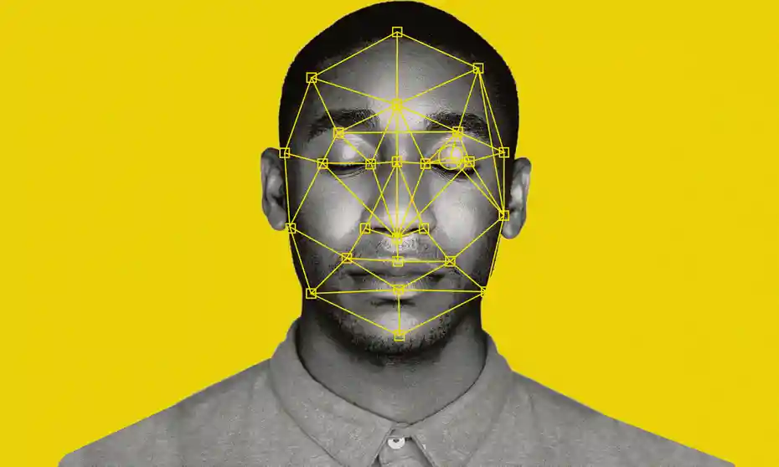
Introduction
Analyze a patient who is about to get Rhinoplasty using ML (Machine Learning).
3 main goals:
Capture 3D image of a patient’s face
Analyze the 3D image and mark significant landmarks on face
Compare images and landmark ratios using ML
Suggest potential changes in facial features.
Allows patients to choose the closet match.
Notes:
you MUST transfer enough information at this time, so the audience can walk away from the presentation, and still know what your project is all about, and what you have accomplished, this is also known as the “60,000 feet view” of your project

Slide 3

Benefits/Importance
Provides patients with the opportunity to see the changes before the surgery.
Assists Plastic surgeons by making surgery easier and more accurate
Presents patients with multiple applicable options to choose from.
Enhances the overall practice of Plastic surgery, benefiting hospitals that provide that service
Potential applications for other reconstructive surgery.

Slide 4
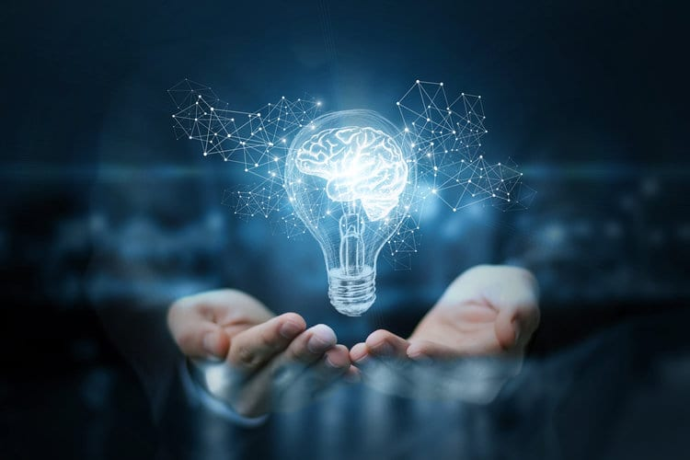
Assumptions & Dependencies
We’re assuming
Clients will submit pictures of themselves without any facial expressions
No face tattoos
No face piercings
Clients will submit the correct pictures to render a 3D image
The algorithm will always come back with multiple suggestions
Dependencies would include
The Blender software
Database we use to store face data
The work done before us

Slide 5

General Constraints
Constraints we will face during this project will include:
Gathering multiple faces for the database
Adding, removing, and editing hardpoints to achieve desired results
Sourcing and implementing multiple ML algorithms OR increasing the amount of suggestions the client receives
Ensuring that uploading a 3D render is easy and accessible for everyone

Slide 6
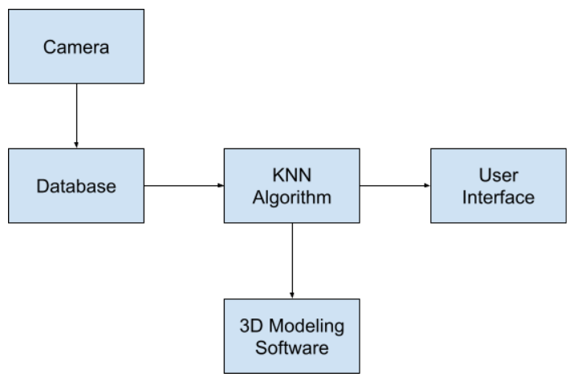
Software Class Diagram

Slide 7
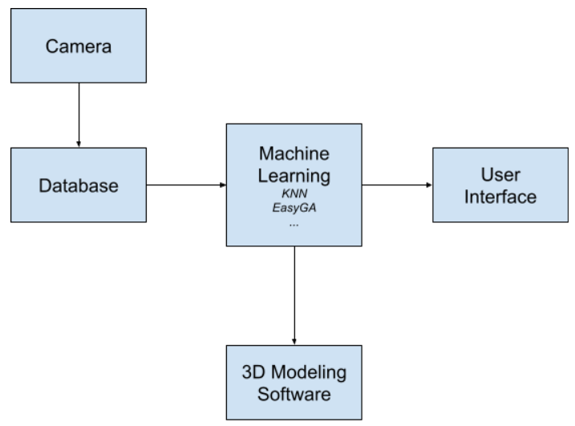
Software Class Diagram

Slide 8
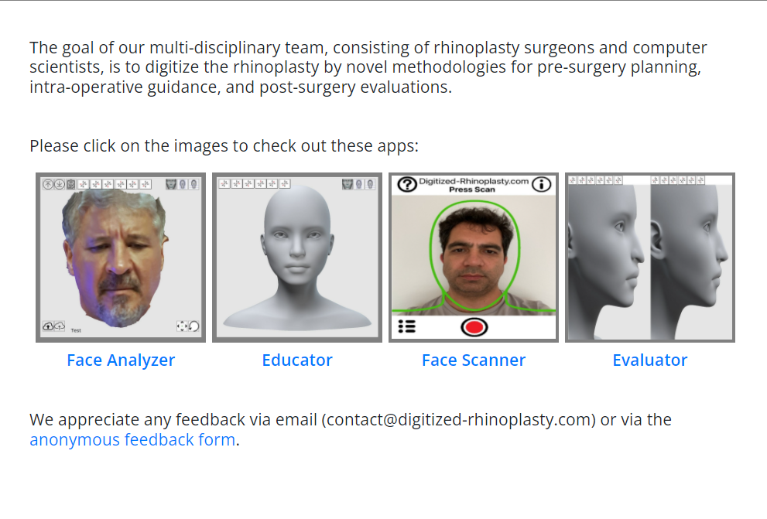
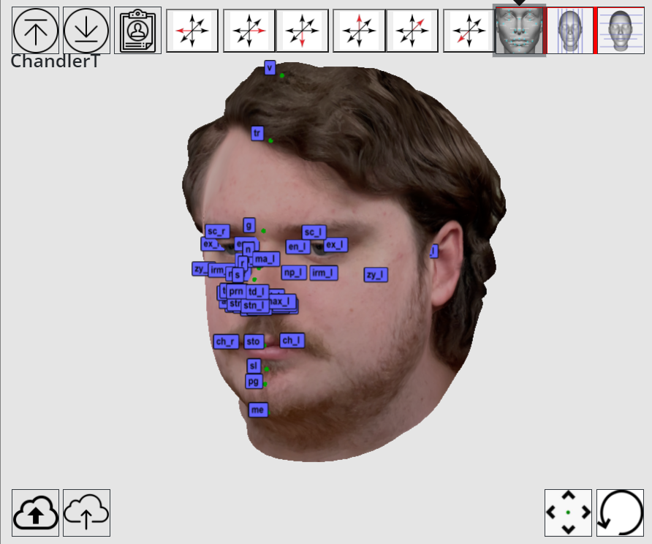
Interfaces / Exports
Digitized Rhinoplasty Web Application

Slide 9
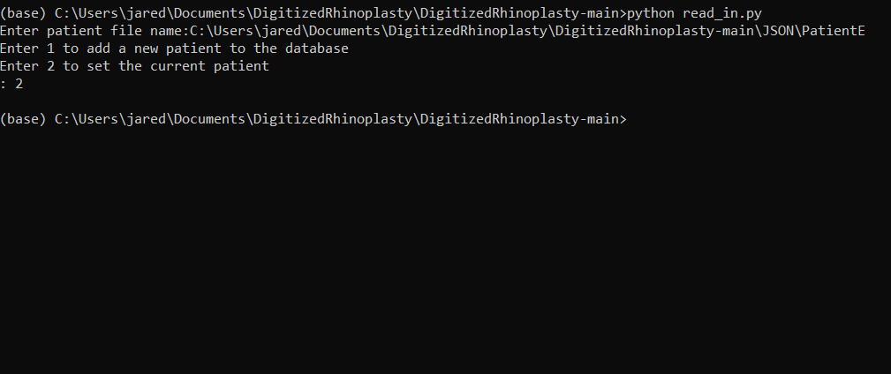
Interfaces / Exports
Command Prompt : Read Input

Slide 10
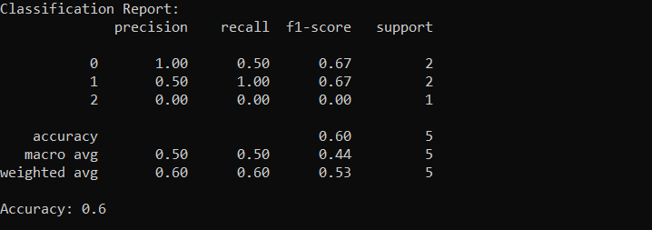
Interfaces / Exports
Command Prompt : Match Faces

Slide 11
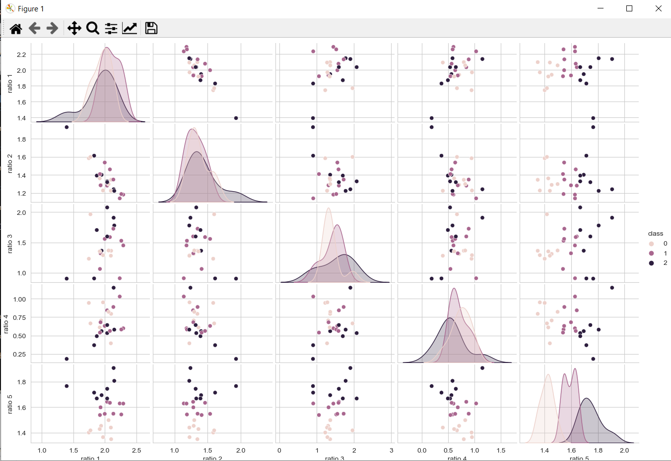
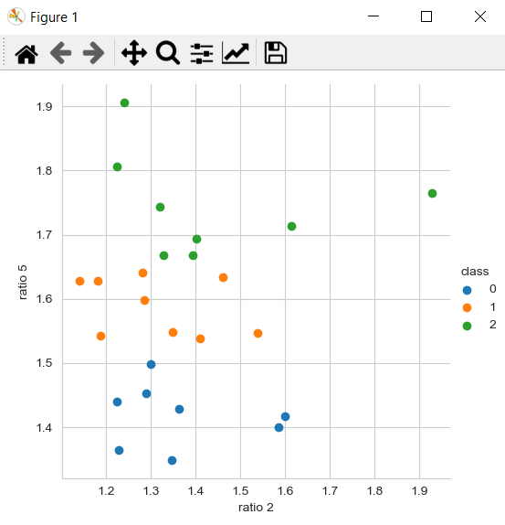
Interfaces / Exports

Slide 12
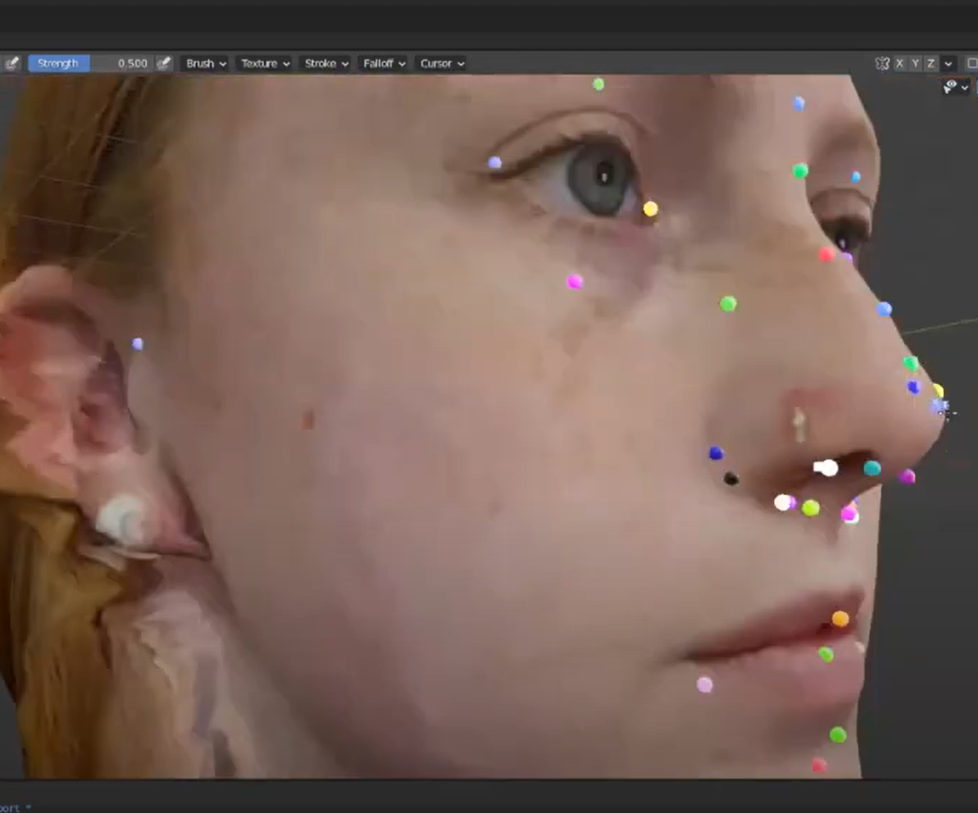
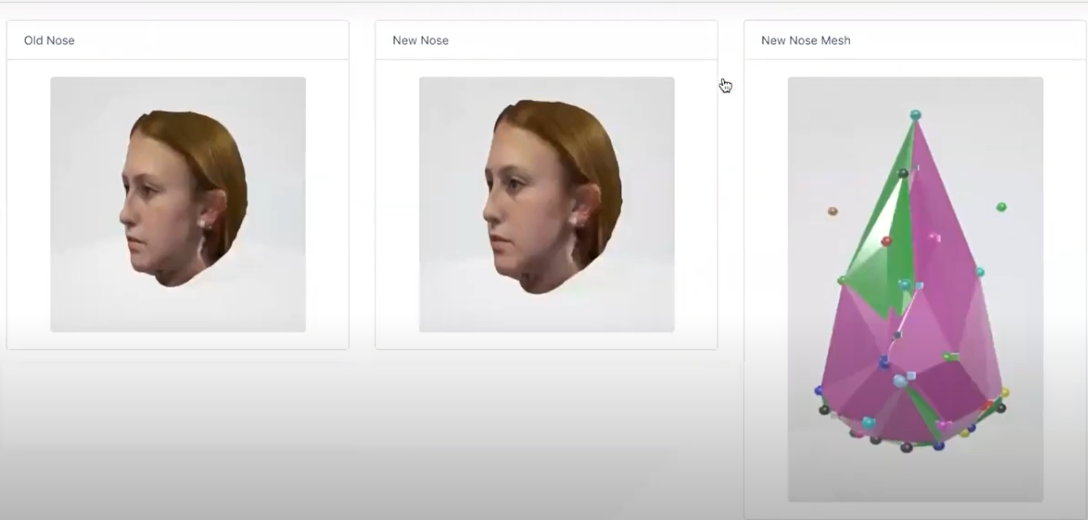
Interfaces / Exports
Blender: 3D Modeling

Slide 13
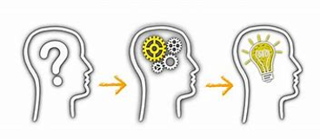
Lesson learned
The main takeaway that we want to learn is that there is no ideal face. Our system will highlight that by showcasing similar faces to the user and then the user picks what nose they believe will look the best on their faces. We hope to give the user the option of them making the decision.

Slide 14

Project Timeline
Basic Project Timeline
Sprint 2:
Research and Select Machine Learning Algorithms for Facial Analyzer
Implement Machine Learning Algorithms
Populate facial image database for ML algorithms
Sprint 3: Test and comparing Facial analyzer ML algorithms for accuracy and efficiency of outputs
Plans for next semester

Slide 15

Questions?

Slide 16

Thank you

